Slide 1

Problem Statement and Team Details
Problem Statement:
Team Name:
Team Leader Name:
Institute Name:
Team Leader Email ID:
For beginners, the stock market can be intimidating. Most apps show prices but don't provide guidance on what actions a small investor should take. As a result, students and new traders often depend on friends, random YouTube tips, or guesswork, which can lead to poor decisions.
Runtime Terrors
Bhuvanagiri Indira Priyadarshini
KL University - Hyderabad
bvipd01@gmail.com

Slide 2
Problem and Solution
Describe your problem statement and how you are solving it.
Problem Statement:
For beginners the stock market is intimidating—apps such as Groww or Zerodha show prices but rarely explain what actions a small investor should take. Many students and first-time traders therefore rely on friends, random YouTube tips or guesswork, risking poor decisions.

Slide 3
Solution:
Stock Dash, a cross-platform application that acts as a personal stock consultant. It uses the Finnhub live market API to convert financial data into easy-to-understand, actionable guidance.
App Flow:
Global Portfolio Support: Users can add stocks from any worldwide exchange using their ticker symbol, including the number of shares and purchase price
Real-Time Updates: The app provides live prices and daily change percentages sourced directly from Finnhub.
Risk Insights: Each stock holding is tagged with a risk level (low, medium, or high) based on volatility and trend analysis
Actionable Advice: The app automatically generates recommendations, such as "Reduce exposure to high-beta IT stocks" or "Add defensive sectors to diversify.“
Portfolio Comparison Graphs: Interactive charts allow users to visually compare multiple portfolios.
Usage & Billing: The app is integrated with Flexprice to track and display usage, such as the number of portfolio analyses or advice reports generated.

Slide 4
Methodology & Implementation
Ticker Resolution: allow raw tickers or search (call Finnhub symbol lookup).
Fetch live data: batch calls to Finnhub quote + profile endpoints.
Normalize data: unify currencies and timestamps (show timezone).
Risk scoring: compute volatility + concentration + recent drawdown → risk label.
Advice rules: simple rule engine (if beta>threshold & large position → “Reduce”).
Visualization: render graphs for value / allocation / risk.
Billing: send a usage event to Flexprice each time advice/portfolio-analysis runs.
Caching & rate-limits: cache results for 1–2 minutes; exponential backoff on API failures.

Slide 5
Technology Used
Frontend: Next.js, Tailwind CSS,React, PWA manifest & service worker.
Backend: Node.js (Express) server or serverless functions.
Data: Finnhub API (quotes, profile, symbol lookup).
Visuals: Recharts or Chart.js for portfolio comparisons.
Billing: Flexprice SDK/webhook.

Slide 6
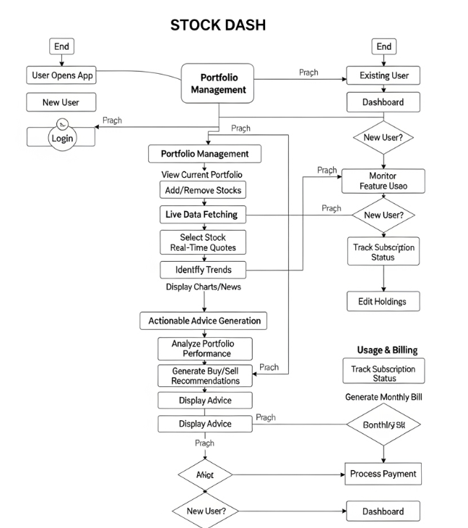
Flowchart

Slide 7
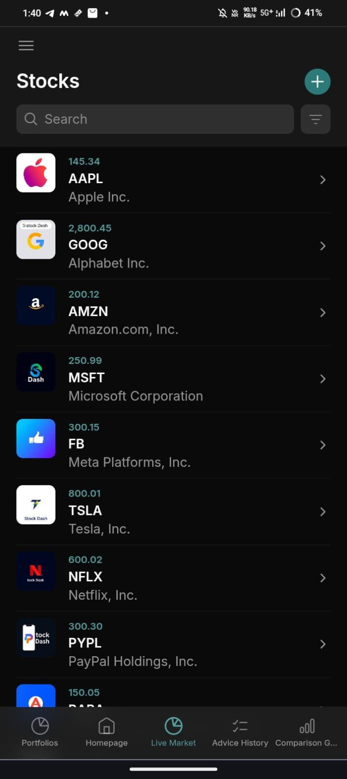
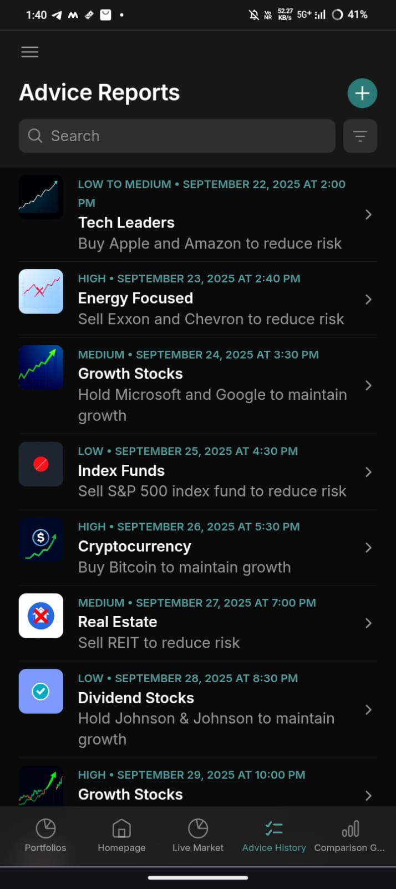
App Images

Slide 8
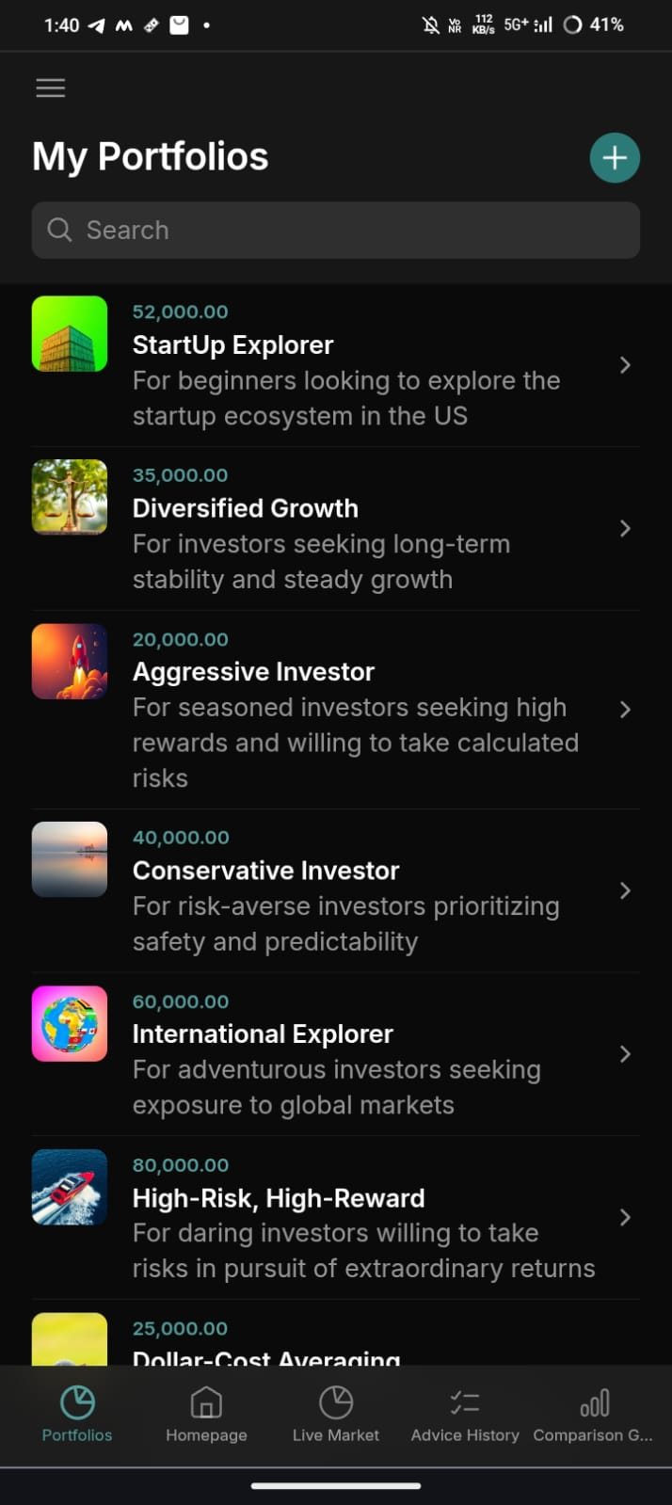
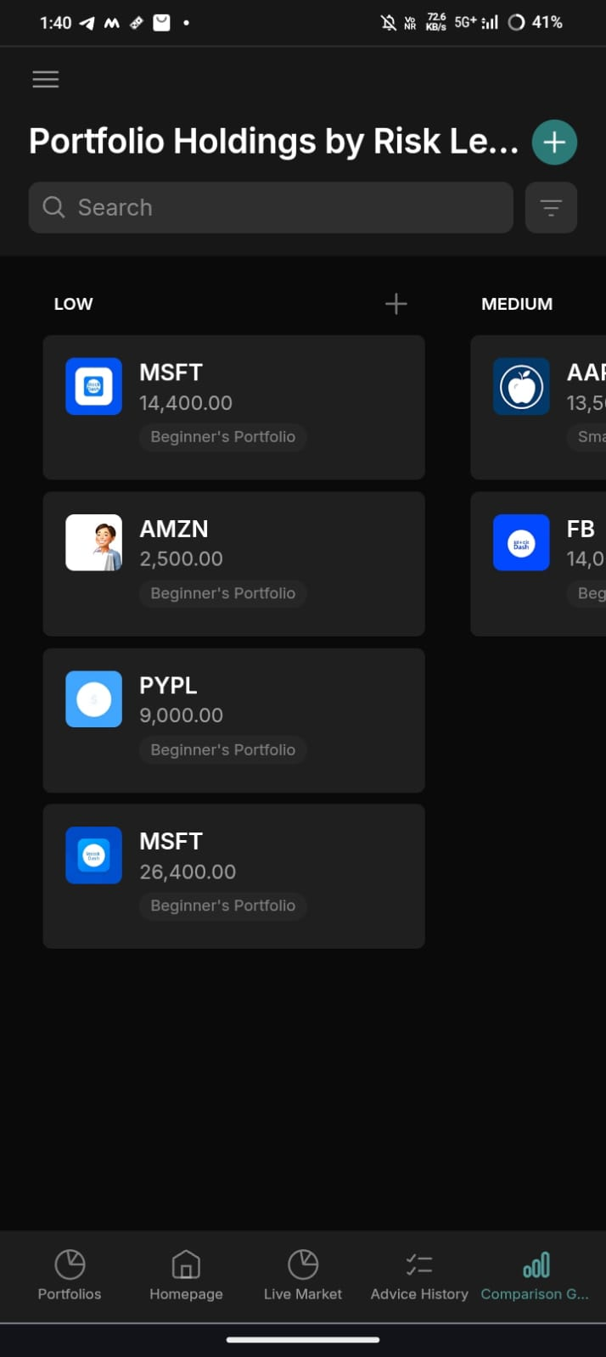

Slide 9
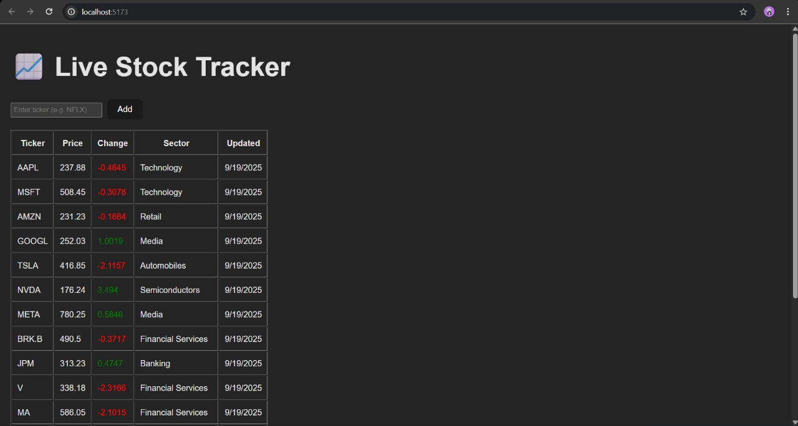
Live Stock Tracker

Slide 10
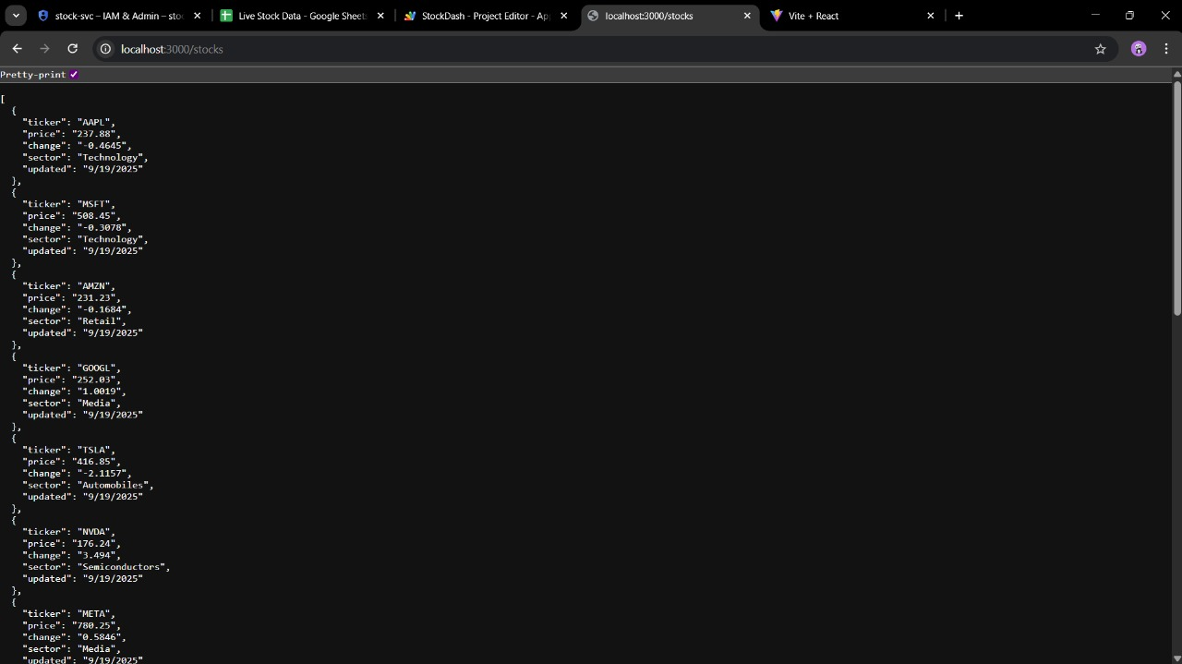
Backend Dataset

Slide 11
Feasibility and Market Use
Target Market: The app's primary target market is students and first-time traders. This group is often underserved by traditional financial services, which can require high minimum balances and charge expensive fees. Robo-advisors like Stock Dash cater to this demographic by being more accessible and cost-effective.

Slide 12
Conclusion
In conclusion, "Stock Dash" addresses the significant problem of new investors feeling intimidated by the stock market by providing a user-friendly, personal stock consultant. The app transforms complex financial data from the Finnhub API into clear, actionable advice, making it accessible for first-time traders and students who might otherwise rely on unreliable sources. Its core features, including global portfolio support, real-time updates, risk insights, and portfolio comparison graphs, offer a comprehensive solution for managing investments effectively. The app's technical implementation, utilizing a modern stack with Next.js and a Node.js backend, ensures a seamless experience as a Progressive Web App (PWA). By combining live data analysis with a simple rule engine and an integrated billing system, "Stock Dash" presents a feasible and practical solution for empowering a new generation of investors to make informed decisions.

Slide 13
github link
https://github.com/BVIPD/Stock-Dash/tree/main

